Slide 1
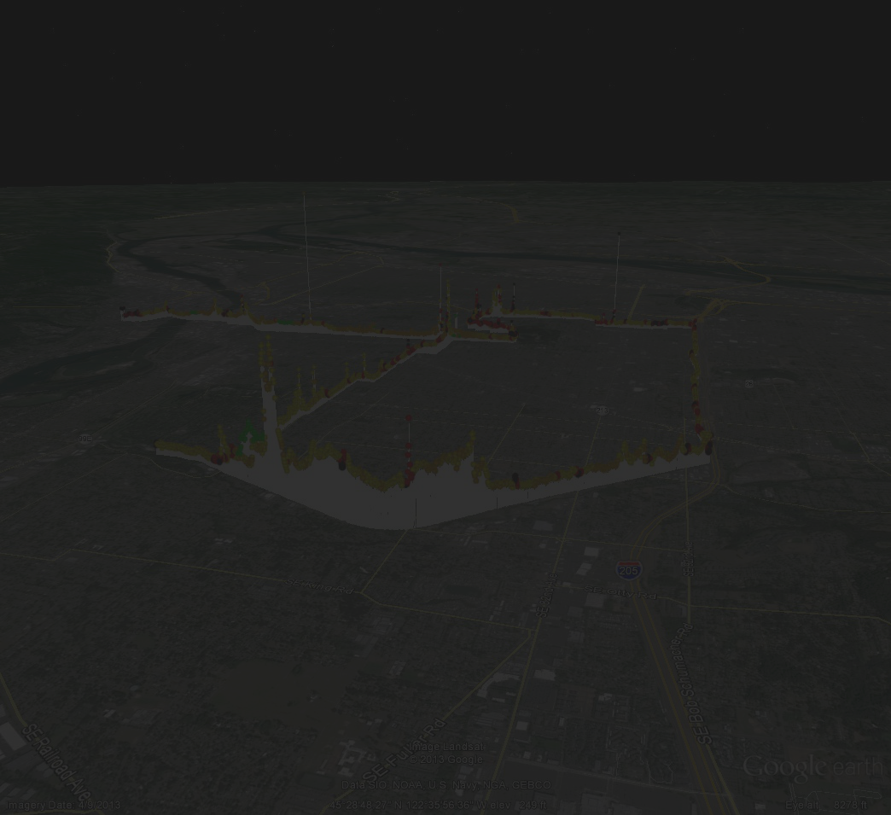
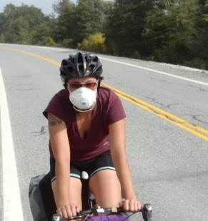
Urban Bicyclists' Uptake of Air Pollution
Considerations for System Design and Use
Alex Bigazzi
Miguel Figliozzi
James Pankow
Wentai Luo
ITE Winter Workshop
26 February, 2015

Slide 2
Active Transportation & Health
Public Health
Exercise
Crashes
Pollution
Emissions
Exposure/
Dose

Slide 3
Effect Pathway
Exposure to Pollution
Traffic
Roadway
Speed
Hills
Stops
Breathing
Uptake dose
Respiratory system
Weather

Slide 4
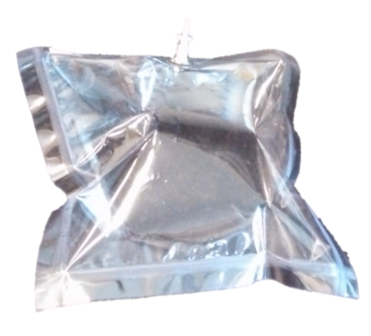
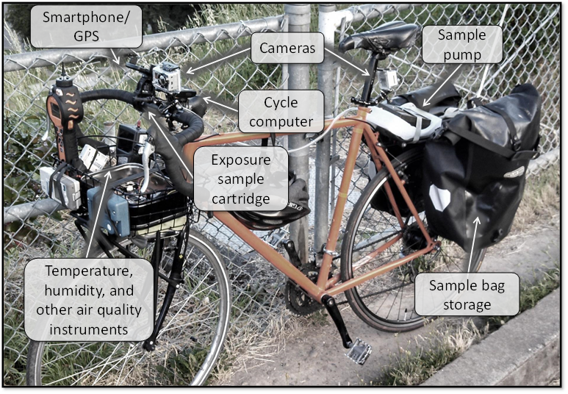
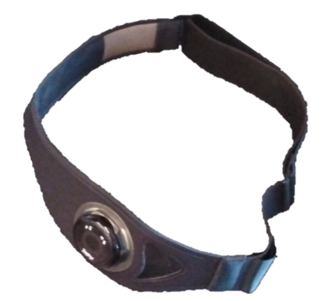
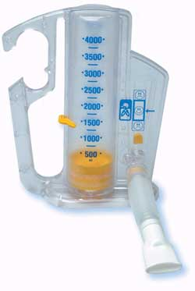
Sampling Equipment

Slide 5
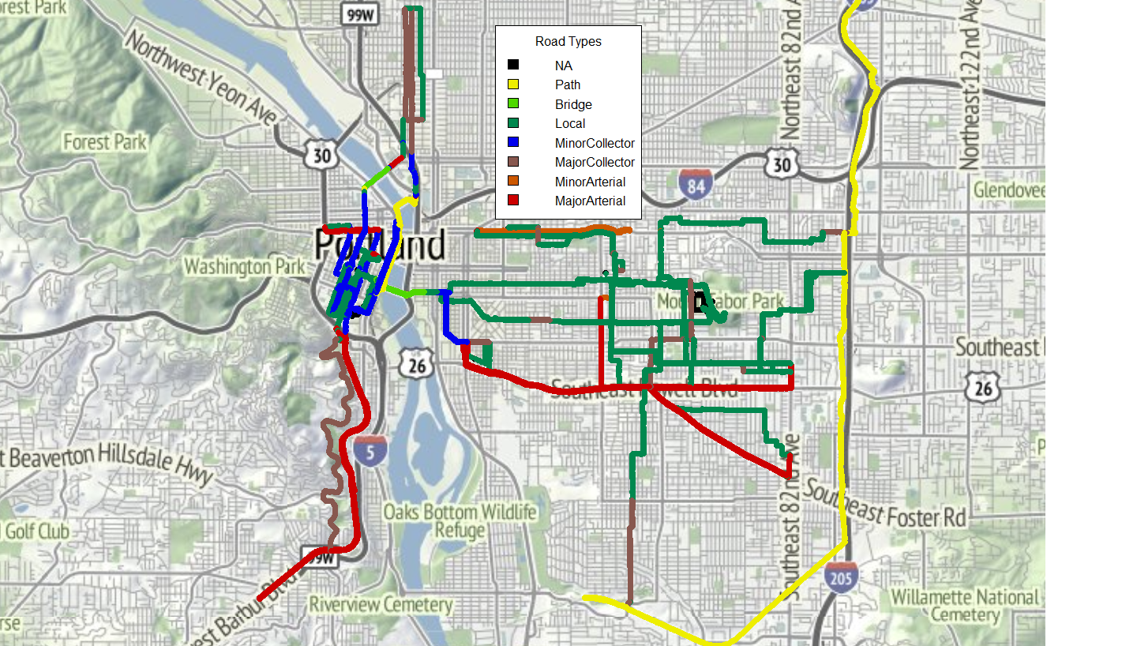
Exposure Data coverage
74 breath samples
3 subjects
9 days
~40 hours of data

Slide 6
Parallel Path Comparison
CO +200%
VOC +60%
CO +220%
VOC +330%
CO +30%
VOC +110%

Slide 7
Findings
Determining factors
ADT
Mitigation
Low-volume streets
Travel speed choice
Reducing stops
Stop-and-go riding
Industrial corridor
Speed & grade
Exposure & ventilation
Separated facilities
Notes:
Contributions: first…
application of breath biomarkers to travelers (new empirical evidence)
quantification of exposure by ADT
Combined analysis of ventilation and exposure on dose

Slide 8
Take-Away Principles
Traffic, weather, and land-use all important
Different pollutants, different effects
Benefits of separation from traffic

Slide 9
Bikeway Design Considerations
Bike lane | High exposure with ADT Dedicated lane avoids queues
Bike boulevard | Low exposure Fewer stops reduces uptake
Cycle track | Lateral separation
Off-street path | Low exposure (nearby industry?)

Slide 10
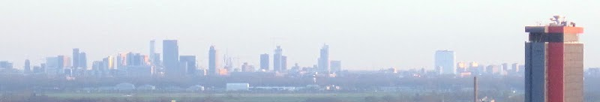



Questions?
Acknowledgments
Dissertation committee: Miguel Figliozzi, Jim Pankow, Robert Bertini, Jennifer Dill
NITC research project with support from City of Portland and Metro
NSF and OTREC fellowships
abigazzi@pdx.edu
alexbigazzi.com

