Slide 1

HSM: Celebrating 5 Years Together
Brian Ray, PE
Casey Bergh, PE
Notes:
Five Years ago the HSM was about to be released. Here we are five years later…what have we learned and how has the practice evolved and benefitted from the HSM?

Slide 2
HSM Promotes Quantitative Safety Methods

Slide 3
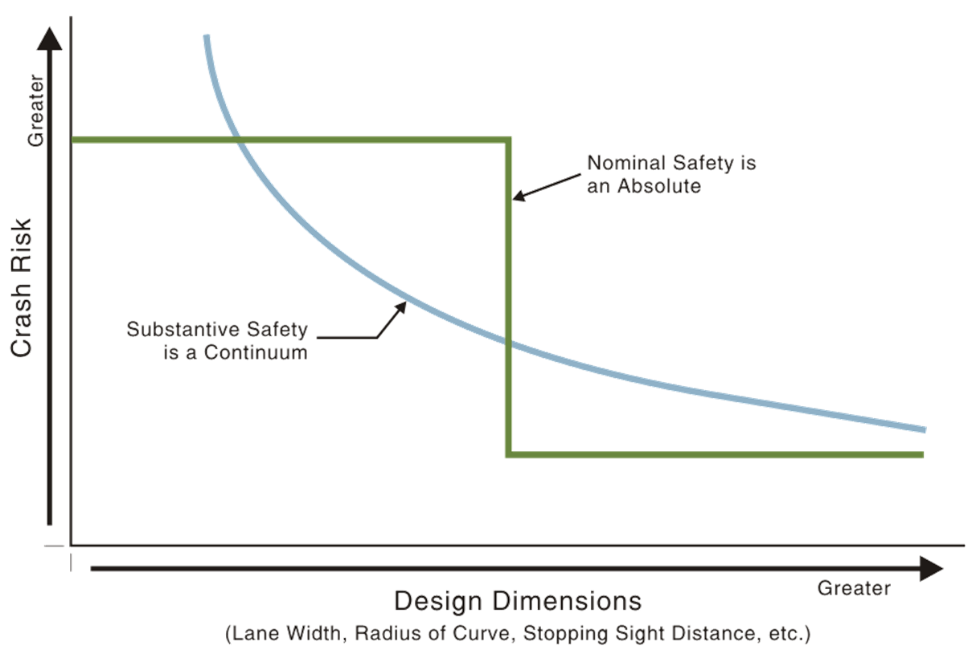
HSM Promotes Quantitative Safety Methods
Source: NCHRP 480

Slide 4
HSM: A Multipurpose Toolbox
Planning, design, construction, operation, and maintenance
System Planning
  HSM Part B
Project Planning & Preliminary Engineering
  HSM Part B and Part C
Design and Construction
  HSM Part C and Part D
Operations and Maintenance
  HSM Part B, C and D
Notes:
It really is applicable to as broad of a range of projects as we thought!

Slide 5
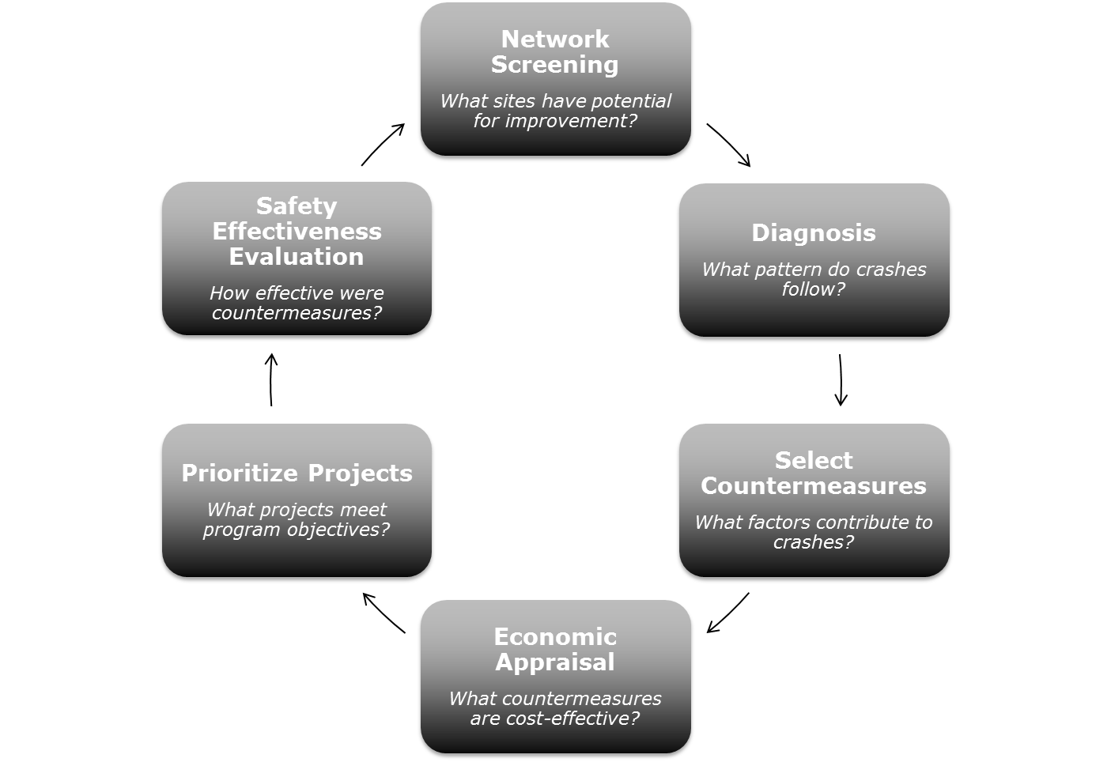
Part B - Roadway Safety Management
Develop understanding of system needs
Inform countermeasure selection
Prioritize projects with potential for crash reduction
Notes:
This process is applicable to every agency. Represents an effective means to incorporate quantitative safety to inform decisions.

Slide 6
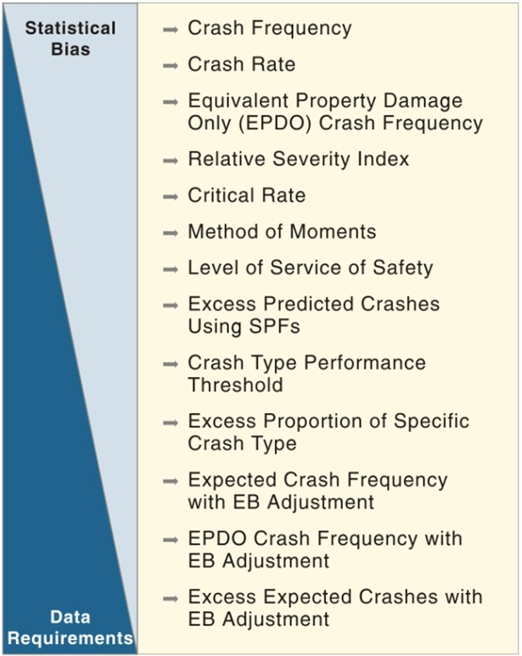
Part B Performance Measures
Multiple performance measures available
  Simple to rigorous
  Data has limited most agencies
Notes:
We’ve learned that most agencies don’t have data to apply the rigorous methods, but we’re using the simple methods and our programs/policies are better because of it.

Slide 7
Part C – Predictive Method
SPFs predict crashes for a base condition
Part C CMFs modify the base prediction to reflect physical conditions (e.g., left-turn lanes)
Notes:
There’s been some confusion between SPFs, CMFs in Part C and CMFs in Part D…

Slide 8
Part D - Crash Modification Factors
Provided in Part D and online in FHWA Clearinghouse
Estimate change in crash frequency associated with a proposed modification
Location - Improvement | Expected Crashes/Yr | Estimated Percent Reduction | Planning Level Cost Estimate | $/Crash Mitigated Over Design Life
Anderson Road Int. - FHWA Lane Narrowing | 2.2 | 31% | $45,000 | $13,196
Anderson Road Int. - FHWA Splitter Island | 2.2 | 68% | $112,500 | $15,040
Moon Road- Access Restriction / Right Turn Lane | 1.9 | 26% | $610,000 | $61,741
Anderson Road- Single Lane Roundabout | 2.2 | 71% | $3.15 million | $100,832
Notes:
The database for CMFs has expanded like crazy in the last 5 years. The online database has become the primary source and 2nd Edition may not include any CMFs in Part D.
CMFs from Part D and the CMF Clearinghouse are limited to 3 per project, otherwise benefit is overestimated.

Slide 9
HSM Applications in OR
State/Region
City/County
Intersection/
Segment
ODOT Pedestrian and Bike Safety Plan
ODOT ARTS
Clark County
Bend
Clackamas County
Road Safety Audits
Intersection Traffic Control Evaluations
US 97 Corridor Safety Study
TSPs
Notes:
HSM has been applied at all levels from broad to intersection-specific

Slide 10
State/Region Network Screening Identifies Sites with Potential for Crash Reduction
Segment screening based on sliding window
ODOT ARTS systemic safety network screening focus areas
  Roadway Departure
  Bicycle and Pedestrian
  Intersection
Notes:
At the highest level, HSM tools have been used at state-wide and region levels. At this level, the goal is to point in the right direction, reducing time spent assessing sites with little potential for crash reduction.

Slide 11
ODOT Region 1 ARTS: Data-informed 300% Systemic Project Locations
HSM Performance Measure: Equivalent Property Damage Only (EPDO) average crash frequency
  Selected to reflect the severity of reported crashes
Applied independently to intersections and segments
  Weighting Factors (consistent with SPIS):
    100 for Fatal or Injury A
    10 for Injury B or C
    1 for PDO
Notes:
We recently applied HSM performance measures to inform ODOT Region 1 in the move to an All Roads Transportation Safety program. It was the first time Region 1 has compared crash locations on all roads in Region 1.
Relatively simple method, but its application represents an efficient application of quantitative tools to establish an objective process

Slide 12
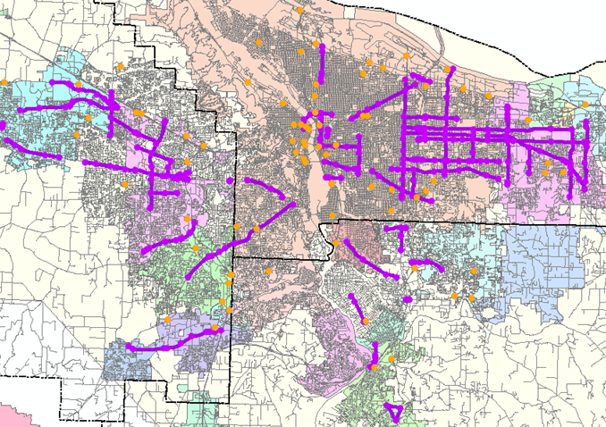
Region 1: Data-informed 300% Systemic Project Locations
Traditional Systemic Analysis
  Use crash history to prioritize intersection crash locations

Slide 13
Statewide Pedestrian and Bicycle Safety Implementation Plan
Risk-based Systemic Safety Analysis
  Crash history is not sufficient to inform pedestrian and bicycle crash risk
Identify Risk Factors
Select and Prioritize Locations
Develop Systemic Safety Projects
Traffic and geometric characteristics present at fatal and severe-injury crash sites
Segments exhibiting one or more risk factors
Apply countermeasures to address risk factors at specific locations
Notes:
At the same level, sometimes data is limited. An alt systemic method being promoted by FHWA uses risk to inform priorities.

Slide 14
Data-Informed Safety Management Plan Example Bend, OR
Goal: Establish a safety management program
  Understand crash patterns
  Prioritize safety projects
  Improve collaboration with other agencies
Current Limitations
Perceived Safety
Reactive
Opportunities
Objective Safety
Proactive
Repeatable
One-time
Individual Efforts
Coordinated Efforts
Notes:
Data not only informs, but it allows for a repeatable process that is more objective.

Slide 15
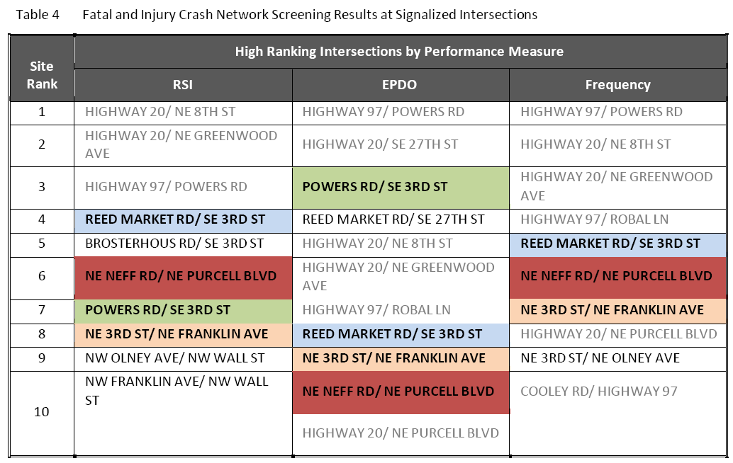
Data-Informed Safety Management Plan Example Bend, OR
Notes:
Applying multiple measures to the same network population indicates sites with potential for reducing severe and frequent crashes.
RSI – Relative Severity Index, EPDO= Equivalent Property Damage Only

Slide 16
Corridor Safety Analysis Example: SR 46
Facility: 7.4 miles of two-lane rural highway in Seminole County, Florida
Goal: Evaluate crash history and identify countermeasures to reduce crash frequency and severity
  Identify project
  cost-benefit ratios to justify
  funding and objectively
  prioritize projects
Notes:
Corridor studies are among the most practical use of prediction tools. Easy to apply, inform decisions, justify funding.

Slide 17
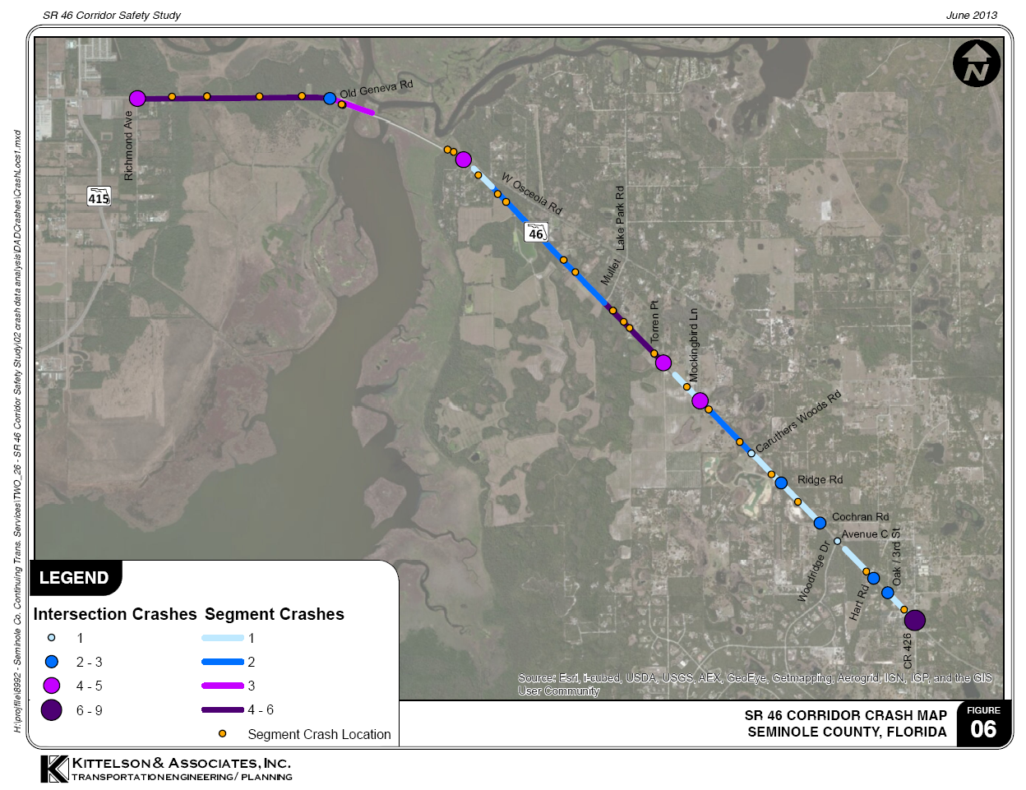
Corridor Safety Study Example: SR 46
Corridor crash trends
  30% rear-end
  24% run-off-road
  45% at night
Contributing Factors
  Careless Driving
  Failure to Yield ROW
  Speed

Slide 18
Corridor Safety Study Example: SR 46
Location | Observed Annual Number of Crashes | Predicted Number of Crashes per Year | Expected Number of Crashes per Year
SR 415 to Richmond Ave | 0.2 | 0.8 | 0.6
SR 46 / Richmond Avenue | 1.8 | 1.1 | 1.4
Richmond Ave to Mullet Lake Park Road | 6.2 | 12.7 | 10.4
SR 46 / Mullet Lake Park Road | 0.2 | 1.6 | 0.9
Mullet Lake Park Rd to Avenue C | 5.2 | 7.3 | 6.4
SR 46 / Avenue C | 0.2 | 2.8 | 1.7
Avenue C to CR 426 | 2.0 | 2.3 | 2.2
SR 46 / CR 426 | 5.0 | 3.1 | 3.6
Total | 20.8 | 31.7 | 26.8
Notes:
Applied Part C CMFs to arrive at these numbers.

Slide 19
Corridor Safety Study Example: SR 46
Notes:
Applied Part D CMFs and those from FHWA Clearinghouse to arrive at these numbers.

Slide 20
Corridor Safety Study Example: SR 46
Tier I Projects
    Low-cost rumble strips, signs
Tier II Projects
    Moderate-cost shoulder widening, turn lanes, intersection lighting, etc.
Tier III Projects
    High-cost passing lane, access management
Notes:
Identify project cost-benefit ratios to justify funding and objectively prioritize projects

Slide 21
What’s Next?
2nd Edition Production through NCHRP 17-73
  Incorporates Freeway and Ramp Prediction Models (Available now)
  Additional Models (e.g., arterials with six or more lanes and one-way arterial streets)
  Increased statistical rigor
  Exclude Part D CMFs

Slide 22
Questions?
Brian Ray
  bray@kittelson.com
  503-228-5230
Casey Bergh
  cbergh@kittelson.com
  541-312-8300
Notes:
Hope to demonstrate how over 5 years the HSM has integrated into all levels of analysis and we’re better for it!

