Slide 1
All Roads Transportation Safety (ARTS) Program
Kevin J. Haas, P.E.
Traffic Investigations Engineer, ODOT
February 26, 2015
Notes:
Title slide option 1

Slide 2
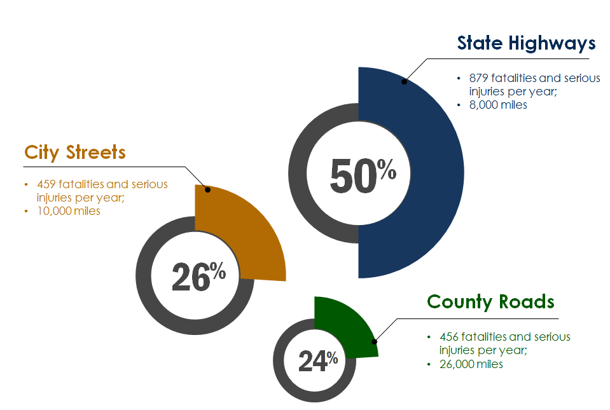
Oregon averages 1800 fatalities and serious injuries per year
Based on 2009-2013 data

Slide 3
Highway Safety Improvement Program (HSIP) federal funding was traditionally only spent on State Highways, but 50% of Fatal and Serious Injury crashes occur on local agency roads
Notes:
“there are 1700 fatalities and serious injuries in Oregon per year”

Slide 4
MAP-21: major themes for HSIP
(Federal HSIP, Section 148 of Title 23)
Reduce Fatalities and Serious Injuries
Use a data-driven approach that is blind to jurisdiction
Emphasizes spending on all public roads
Requires Performance-Based Measures (States set targets)
Fatal and serious injury crashes per VMT
Number of fatalities and serious injuries
New roadway data and highway basemap requirements

Slide 5
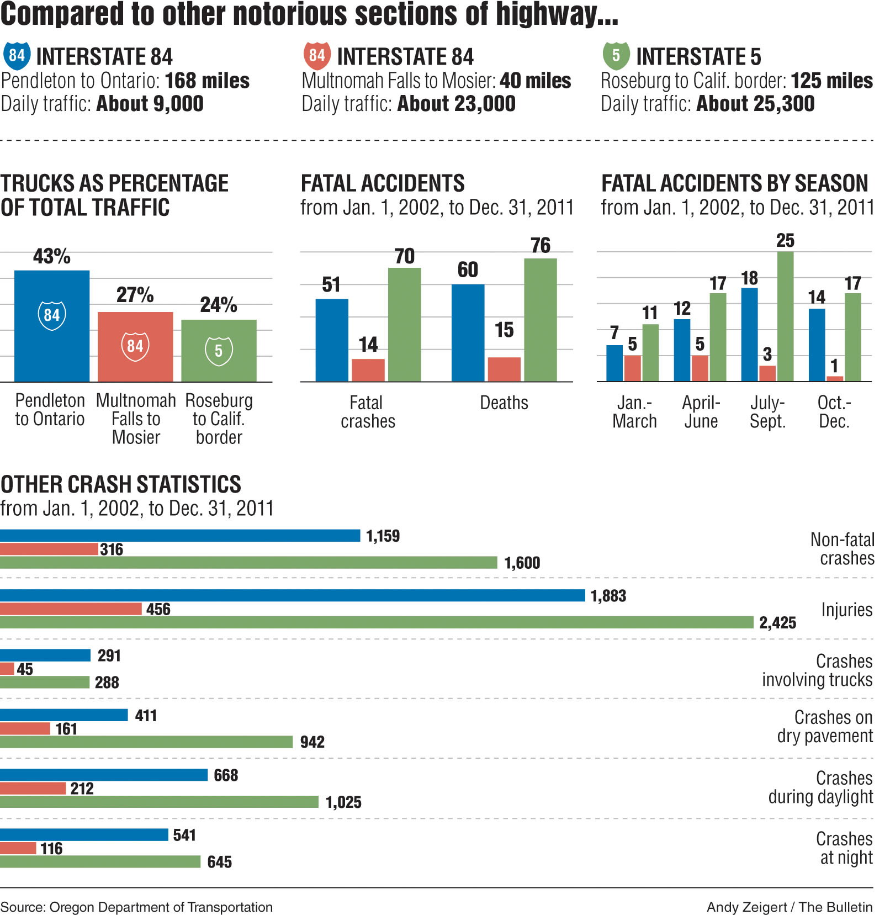
Data-driven process
A data-driven approach uses crash data, risk factors, or other data supported methods to identify possible locations to achieve the greatest benefits

Slide 6
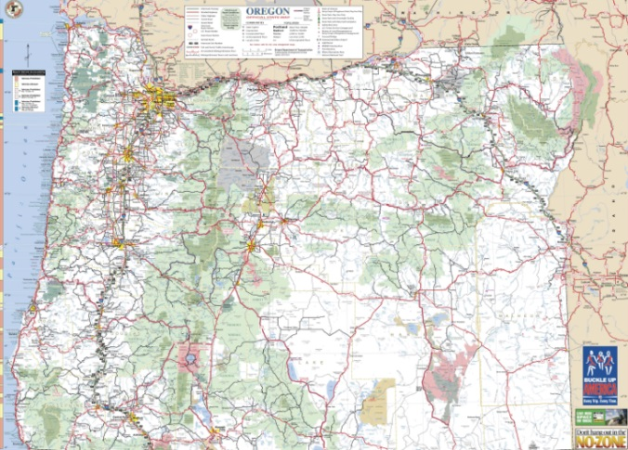
Jurisdictionally blind safety discussions initiated in 2012
ODOT met with representatives from the League of Oregon Cities (LOC) and Association of Oregon Counties (AOC)
Need for developing a safety program for all public roads
Memorandum of understanding between ODOT, AOC, and LOC
Agreed to All Roads Transportation Safety (ARTS) program

Slide 7
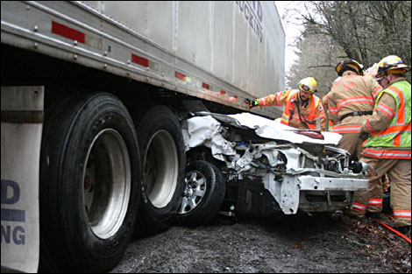
ARTS program principles
Select the best projects to reduce fatalities and serious injuries
Address safety on all public roads
Data-driven and blind to jurisdiction
Overseen by ODOT Regions

Slide 8
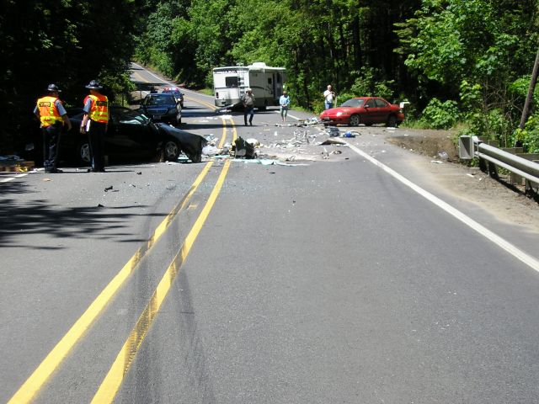
ARTS funding principles
Allocations to each ODOT Region based on fatalities and serious injuries on all public roads
Projects focused on fatal and serious injury crash reductions

Slide 9
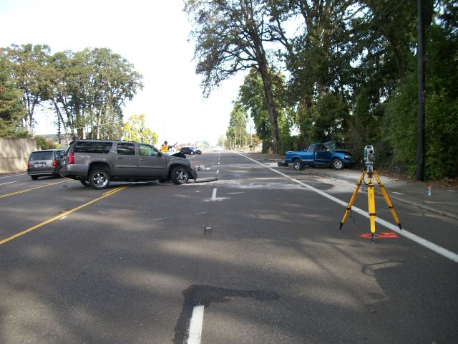
Project selection principles
Primarily developed and overseen by ODOT
Regional project selection engages local jurisdictions
Combine projects on state and local roads where possible
Follow principles of practical design

Slide 10
ARTS program timelines

Slide 11
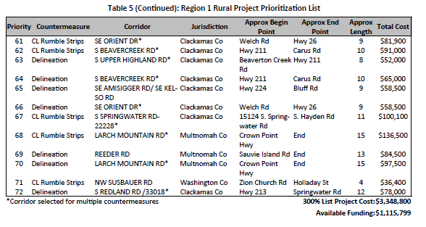
Transition program for cities and counties
Developed to bridge the gap between 2013 and 2017

Slide 12
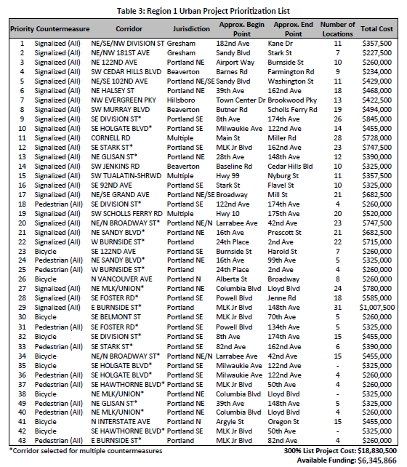
Transition program
ODOT hired a consultant to facilitate the process in each region
Local Jurisdictions participated in selection of a few key systemic measures in each region
ODOT region staff taking the lead on developing the projects
Projects should be designed and underway 2015-2016

Slide 13
Transition program funding for cities and counties (2013-2016)
Region | Splits* | Funds
1 | 46.6% | $7,461,665
2 | 27.3% | $4,370,457
3 | 14.6% | $2,333,411
4 | 7.5% | $1,207,972
5 | 3.9% | $626,495
Total |  | $16,000,000
*Splits based on F&A crashes on local roads

Slide 14
ARTS program funding begins in 2017
ARTS
Hot Spot
(50%)
Systemic
(50%)
Roadway Departure
(50%)
Intersection
(36%)
Bike/Ped
(14%)
Numbers in ( ) represent approximate funding split (statewide)

Slide 15
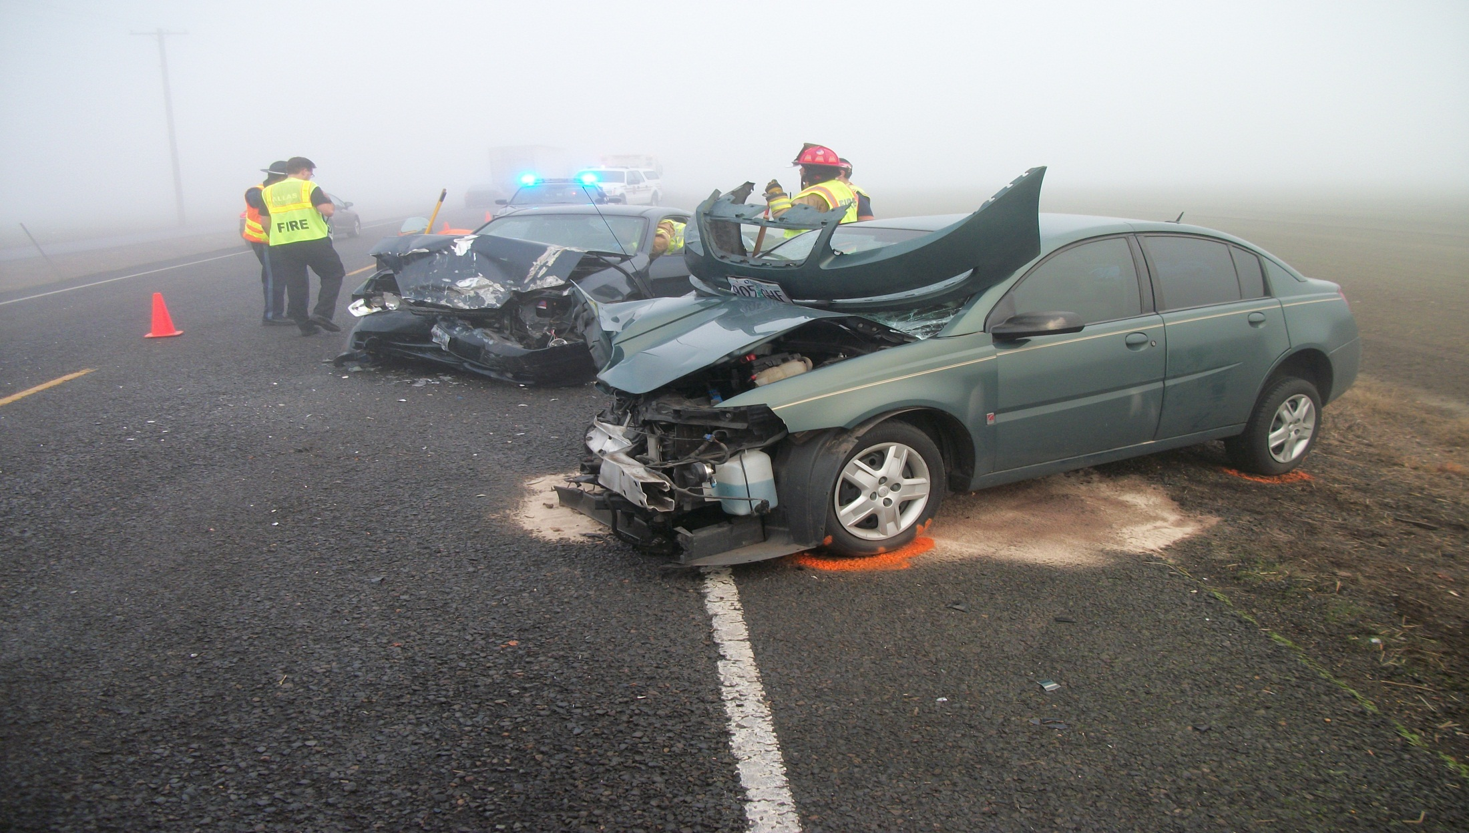
Hot Spot
Using traditional hot spot method, locations with histories of fatal and serious injury crashes will be targeted

Slide 16
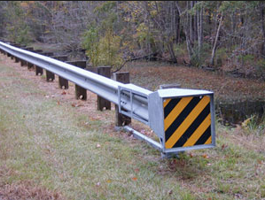
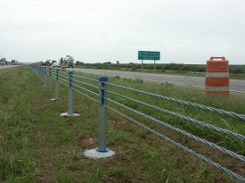
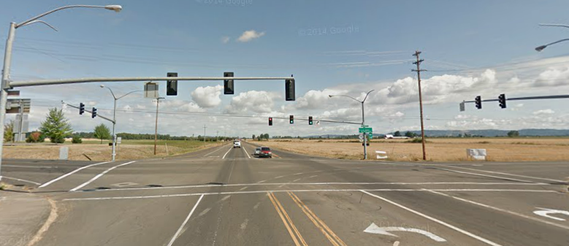
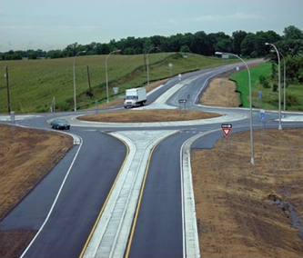
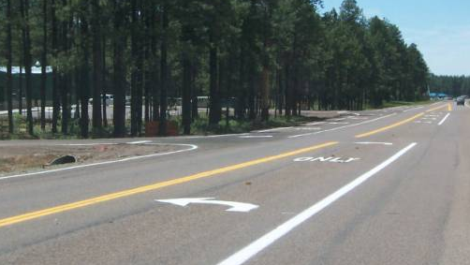
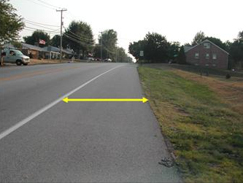
Hot spot countermeasures
Courtesy: FHWA

Slide 17
Hot spot project selection
A 300% list of potential project locations (for each Region)- prepared by consultant
Data-driven analysis
ODOT approved screening method using ODOT reported crashes only
Locations shall have at least one F & A within last five years
Countermeasures from ODOT CRF List
Prioritized/categorized based on B/C Ratio (using ODOT method)

Slide 18
Hot spot project selection
One kick-off meeting per Region
Discussion on selection process and preliminary results
Input from participants
Participants may suggest additional project(s) that are not in the list
Additional analysis and refinement of the preliminary list based on input
Meeting to discuss finalized list of potential projects

Slide 19
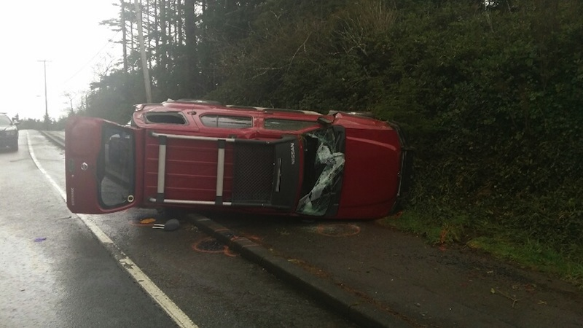
Systemic
Systemic approach will be used for low-cost countermeasures that can be widely implemented to reduce fatalities and serious injuries

Slide 20
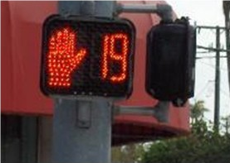
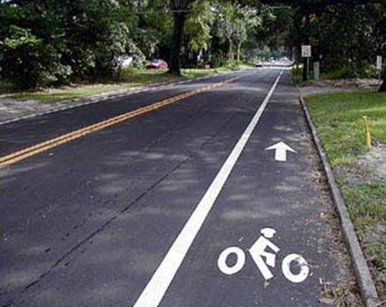
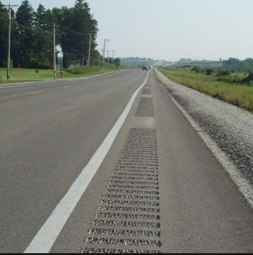
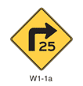
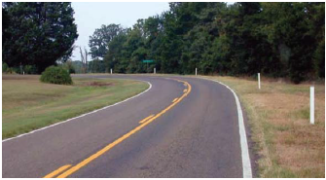
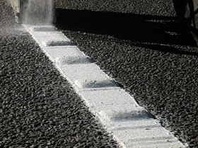
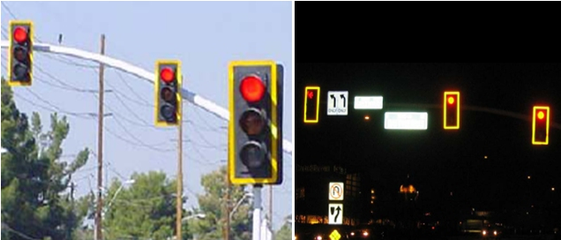
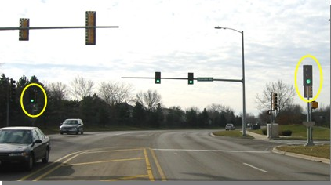
Systemic countermeasures
Courtesy: FHWA

Slide 21
Systemic countermeasures
Countermeasure | CRF | Crash Type | Typical Cost
Curve Warning Signs with Speed Riders | 13% | All | $500-$700 per sign
Oversize Curve Warning Signs | 18% | All | $500-$600 per sign
Chevrons Placed in Accordance with 2009 MUTCD | 20%-35% | All (dependent on facility type) | $300-$500 per sign
Centerline Rumble Strips | 12% | All Rural 2-Lane Roads | $700-$1000 per mile
Centerline Rumble Strips | 21% | Head on & Sideswipe | $700-$900 per mile
Shoulder Rumble Strips | 22% | All Rural MultiLane/ two lane | $700-$1000 per mile
Profiled Pavement Markings | 10% | All | $1.50-$2.50 per foot
First Time Installation of Delineators Where None Existed Before | 11%/34%/67% | All/Run off Road/ Head-On | 500 ft curve = $210-$420 1,000 ft curve = $270-$540

Slide 22
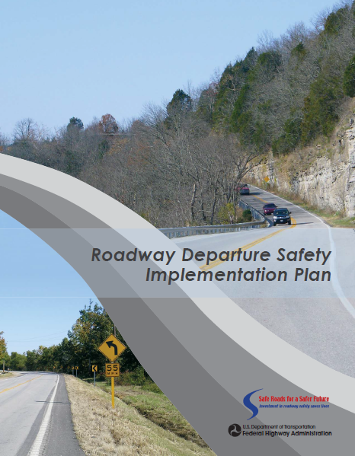
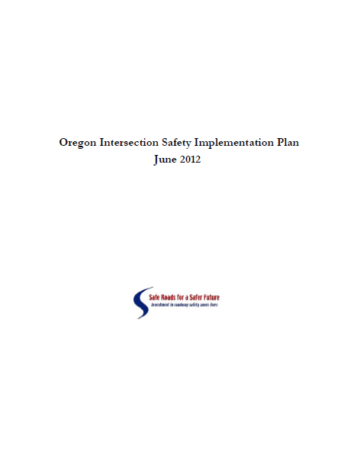
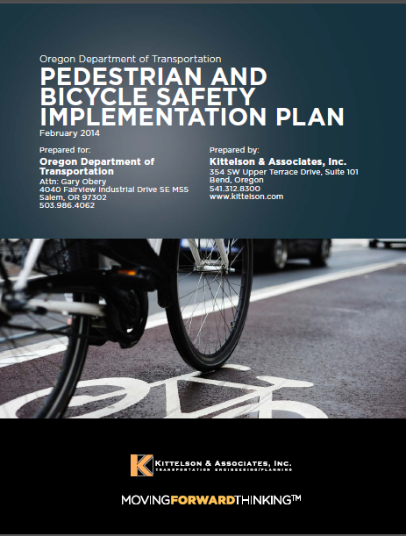
Systemic projects
Shall not require acquisition of a significant amount of ROW
Should have a history of F & A and preferably used on priority corridors from Systemic Plans

Slide 23
Systemic projects
Application-based selection
ODOT and Local Jurisdictions within a Region will submit applications
Regions will process the applications and prepare a 150% list
Multi-discipline assessment to verify the solution

Slide 24
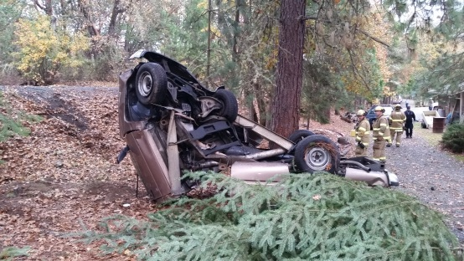
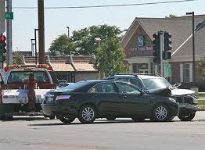
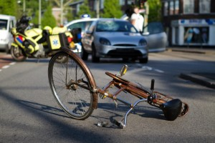
Systemic project selection
Three pots of money
Regions have flexibility to determine the split, but should roughly be equivalent to the proportion of F & A within the Regions

Slide 25
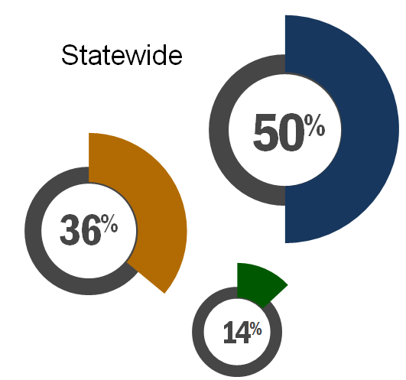
Systemic projects
Region 1 fatalities and serious injuries
Roadway Departure
801 fatalities and serious injuries
31%
Intersectional
1,239 fatalities and serious
injuries
Ped/Bike
544 fatalities and serious injuries
48%
21%
Based on 2009-2013 data

Slide 26
Systemic projects
Region 3 fatalities and serious injuries
Roadway Departure
786 fatalities and serious injuries
Intersectional
304 fatalities and serious
injuries
65%
25%
Ped/Bike
125 fatalities and serious injuries
10%
Based on 2009-2013 data

Slide 27
Systemic application process
ODOT has developed application process and forms
Countermeasures from approved ODOT CRF List
Based on B/C Ratio or Cost-Effectiveness Index
ODOT will provide technical assistance, if asked
http://www.oregon.gov/ODOT/HWY/TRAFFIC-ROADWAY/Pages/ARTS.aspx

Slide 28
HSIP funding
A federal reimbursement program NOT a federal grant program
Requires a 7.78% non-federal cash match
92:8

Slide 29
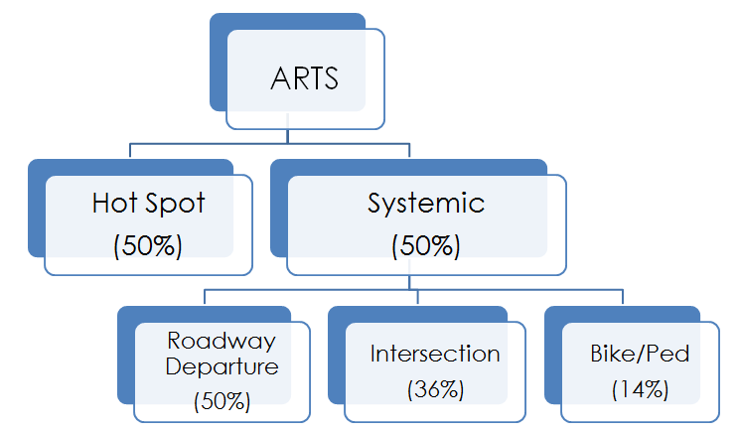
ARTS funding- statewide (2017-2021)

Slide 30
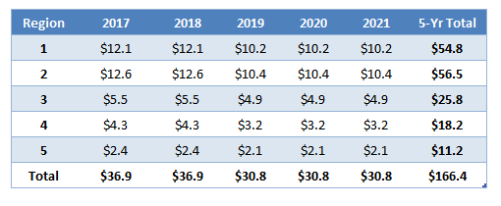
ARTS funding- regions (2017-2021)

Slide 31
ARTS funding by ODOT Region (2017-2018)
Region 1
$12.1 M
Region 2
$12.7 M
Region 5
$2.4 M
Region 4
$4.3 M
Region 3
$5.5 M
Based on 2007-2011 crash data

Slide 32
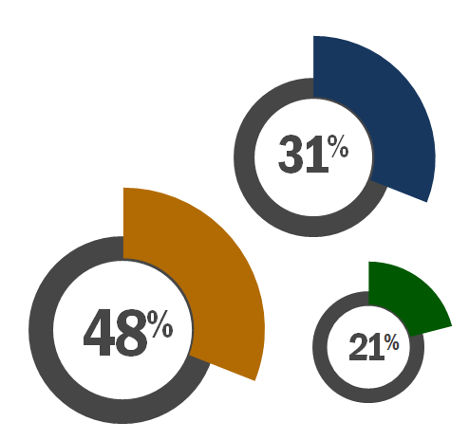
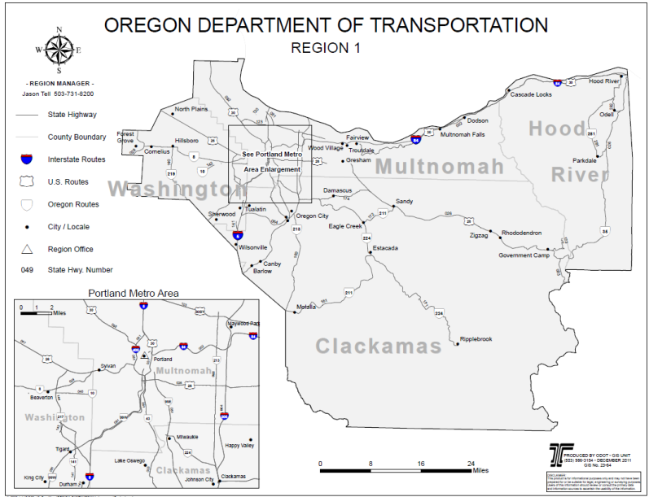
ARTS funding- Region 1 (2017-2018)
Program | Funding per year (in millions)
Hot Spot | $6.0
Systemic
Roadway Departure | $1.9
Intersection | $2.9
Ped/Bike | $1.3
Total | $12.1
Based on 2009-2013 crash data

Slide 33
ARTS funding by ODOT Region (2019-2021)
Region 1
$10.2 M
Region 2
$10.4 M
Region 5
$2.1 M
Region 4
$3.2 M
Region 3
$4.9 M
Based on 2009-2013 crash data

Slide 34
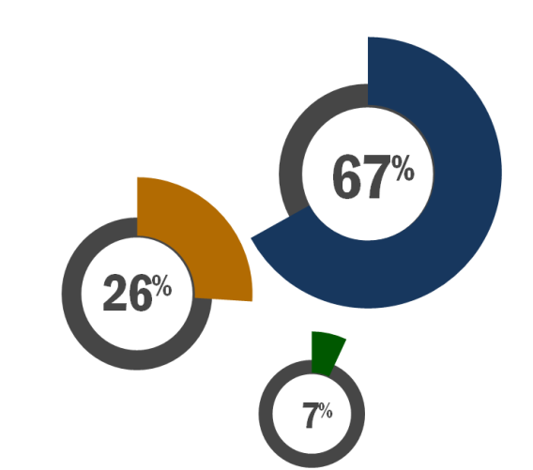
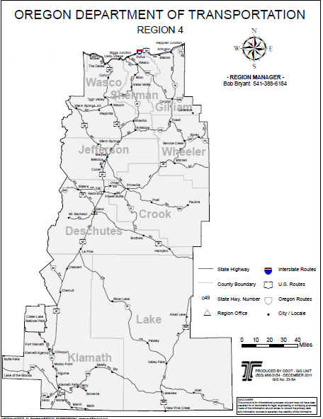
ARTS funding- Region 4 (2019-2021)
Program | Funding per year (in millions)
Hot Spot | $1.61
Systemic
Roadway Departure | $1.08
Intersection | $0.42
Ped/Bike | $0.11
Total | $3.21
Based on 2009-2013 crash data. All splits are approximate.

Slide 35
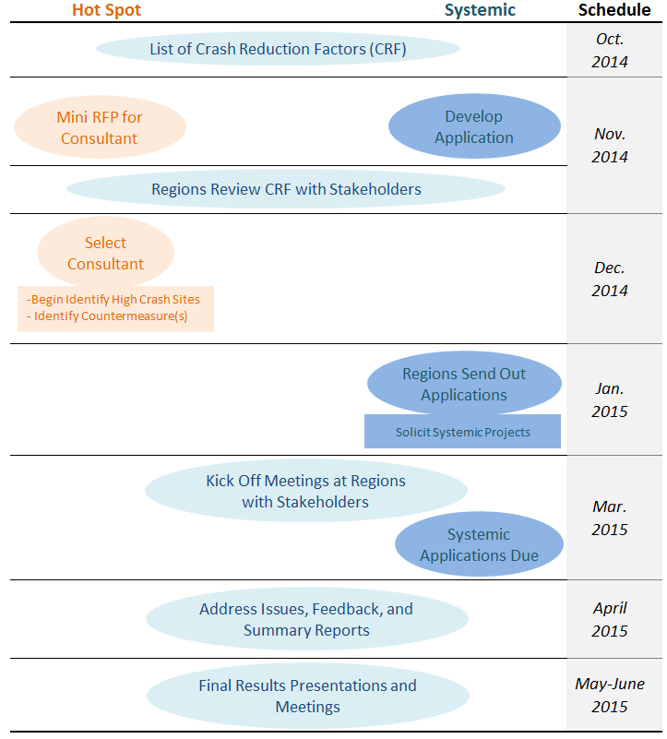
Where are we?

Slide 36
Where are we?
Hot Spot
Working on
300% List
Draft 300% List/Meeting with Local Agencies
Address Comments, Review Proposals, Refined 300% List
Final 300% List
Draft 150% List
Final 150% List
Scoping
Draft
STIP
2015
Feb Mar Apr May Jun Jul Aug Fall 2016
Systemic
Application Deadline
Scoping
Draft
STIP
March 27

Slide 37
Questions about ARTS? Contact your ODOT Region ARTS representative
Sue D‘Agnese (503) 731-3427
Angela Kargel (503) 986-2656
Jeff Wise (541) 963-1902
Joel McCarroll (541) 388-6189
Ext 239
Shyam Sharma (541) 774-6335
http://www.oregon.gov/ODOT/HWY/TRAFFIC-ROADWAY/Pages/ARTS.aspx

